Slide 1
EMERGE
Providing real-life clinical experiences for remote learners
Claire Draudt, BSN, RN, MSN-FNP student
Harn Chiu, BSN, RN
Notes:
Today we're going to talk about an integrated remote learning platform for health care students

Slide 2

Notes:
So this is Anna. She's a senior in nursing school, Her mom's a nurse, her aunts are nurses, and she's been waiting her whole life to be a nurse. This pandemic- she was born for this. All she wants to do is take care of patients

Slide 3
NEeds clinical experience to graduate
...But rotations are cancelled
Notes:
HOWEVER, she has 120 more clinical hours to do before she can graduate, and her hospital—all hospitals—have cancelled rotations. There's not enough PPE to go around and they don't want to put an unlicensed, untrained person at risk. Anna can not graduate without these hours.

Slide 4
How do we get her to the front lines?
Notes:
How can we get her the clinical experience she needs? We need Anna on the front line, not stuck in senior year of nursing school

Slide 5

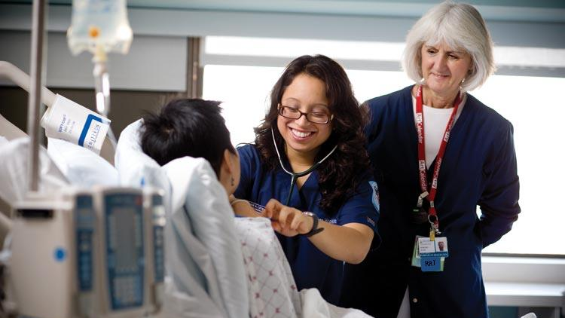
Problem:
> 44,000 NURSING STUDENTS
> 85 MILLION CLINICAL HOURS
> required for board certification
Notes:
And she's not unique, right?
There's
>44,000 NURSING STUDENTS EXPECTed TO GRADUATE IN 2020 >that's 85 MILILON CLINICAL HOURS NEEDED, NATIONALLY, and they're required for board certification.
If nursing schools can't put these 44,000 nurses into the workforce, then they're essentially useless

Slide 6
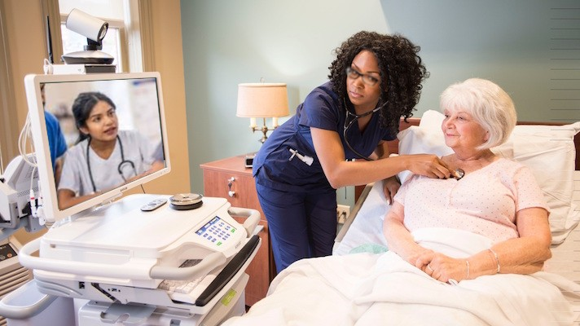
EMERGE: AN INTEGRATED REMOTE TEACHING PLATFORM
EXISTING TECH
POV VIDEO LIVESTREAMING
MIC IN STETHOSCOPE
REAL-TIME STUDENT PARTICIPATION
EMR INTEGRATION
Notes:
Our solution for this is EMERGE, an integrated remote teaching platform. It's almost like facetiming into the room, except the learner's home laptop is hooked up to the mic in the stethoscope and glasses cam their teacher is wearing, and Anna also has remote access to the EMR so she can practice charting AND she can practice looking up someone's history and correlating that to the live patient she sees in front of her.
This platform allows a learner to be "in" the room with their preceptor, even if they can't physically be there AND it utilizes EXISTING TECHNOLOGY INTEGRATED WITH WHAT THE HOSPITAL and the students are already using

Slide 7
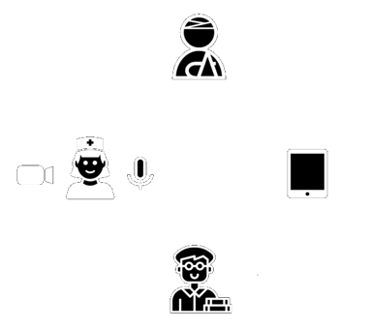
EMERGE: AN INTEGRATED VIRTUAL TEACHING PLATFORM
PRECEPTOR WORKFLOW PRESERVED
STUDENT
REALISTIC, MEANINGFUL LEARNING
SCHOOLS
EASY, FAST, AFFORDABLE
Notes:
Why it's great: for the preceptor it's minimally disruptive and easy to learn. There's nothing extra to hold and this person teaches and works almost as they normally naturally would. Additionally if the patient consents to be recorded, that content's reusable and help many other students.
For the student, they get an immersive first person point of view as well as live interaction with the patient and preceptor. They get to experience and participate in real time clinical decision making, improvisation, and work pressures.
For the school this is easy to implement and train on, low cost, and honestly the only option of its kind.

Slide 8
 | Classroom | Virtual Sim | EMERGE | In-Person Clinicals
Theoretical knowledge | X | X | X | X
Situational critical thinking |  | X | X | X
Interpersonal skills |  |  | X | X
Real-time decision-making |  |  | X | X
Environmental challenges |  |  | X | X
Hands-on practice |  |  |  | X
Clinical Experience Gap
Notes:
What they're using right now is virtual simulations, which is a CGI or prerecorded patient who takes the learner through a scripted scenario
and it's good to practice problem solving- BUT we don't get to develop interpersonal skills and real time decision making. You don't get the pressure of being in a cluttered environment where you can't find your blood pressure cuff and you're struggling with your PPE and the medication dispenser is empty.
With our platform students might not get to place the IV, but they can watch through their preceptors eyes as this expert does it in real time. Learners are getting a personal, interactive, immersive masterclass.

Slide 9

Outcomes:
Schools need a remote learning option
Learners need meaningful clinical experience
Access to library of real-time clinical experiences for future learning opportunities
Enables students to graduate, take boards and join the workforce!
Notes:
So why buy?
Pandemics will happen again
Technology is the future
Remote learning has become inevitable
There is currently no other option that gets learners as close as we can to the real thing. Nursing schools have to adapt and adopt or become obsolete
This platform helps learners gain meaningful experience and improve their clinical skills in real life, real time scenarios
It potentially builds a library of invaluable clinical experiences for future learning***
Most importantly, it GRADUATEs our future health care providers and get them into the work force!
Other uses: far clinical sites, other opportunities, psych

